Slide 1
Hands on Generative AI
Transforming NLP
Notes:
Multi-headed attention and Transformers

Slide 2
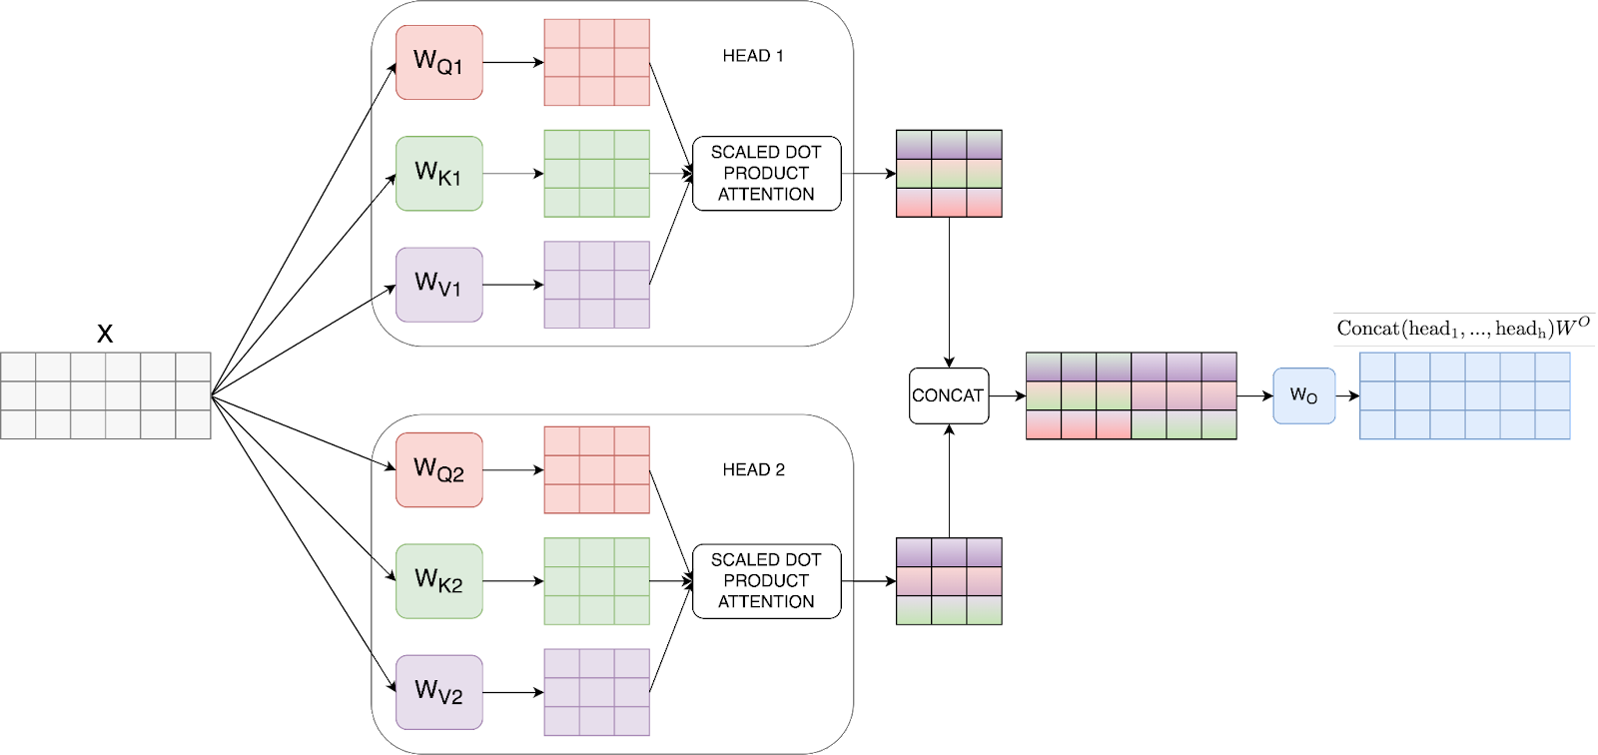
Transforming NLP
Notes:
However, before getting to Transformers we are very very close, we first need to understand Multi Headed Attention. In a nutshell, multi-headed attention is the following image:
As you can see, the idea, inspired by convolutional networks, is that by doing scaled dot product attention as we did before, but many times; we can learn different aspects of the language. The key part here is the weights WQ, WK, and WV for each head. As those are learnable then each query, key and value for each head will be different, even if the same input X is given. That is key.
In the end, we do the same attention as before, we concatenate and that's it!

Slide 3
In summary:
Transforming NLP
Multi-Head Attention is a vital component within Transformers.
Notes:
So, in summary:
Multi-Head Attention is a vital component within Transformers. It enhances the model's ability to capture different types of relationships within the input sentence. By employing multiple attention heads, the model can attend to different parts of the input simultaneously.

Slide 4
An example:
Transforming NLP
Positive:
I loved the restaurant even though the pasta was mediocre
Negative:
I hate this place even though it has fantastic steak
Notes:
As an example, In sentiment analysis, the Multi-Head Attention mechanism enables the model to understand the sentiment-bearing words in a sentence, providing a more nuanced understanding of the sentiment expressed like:
I loved the restaurant even though the pasta was mediocre -> positive
I hate this place even though it has fantastic steak -> negative

Slide 5
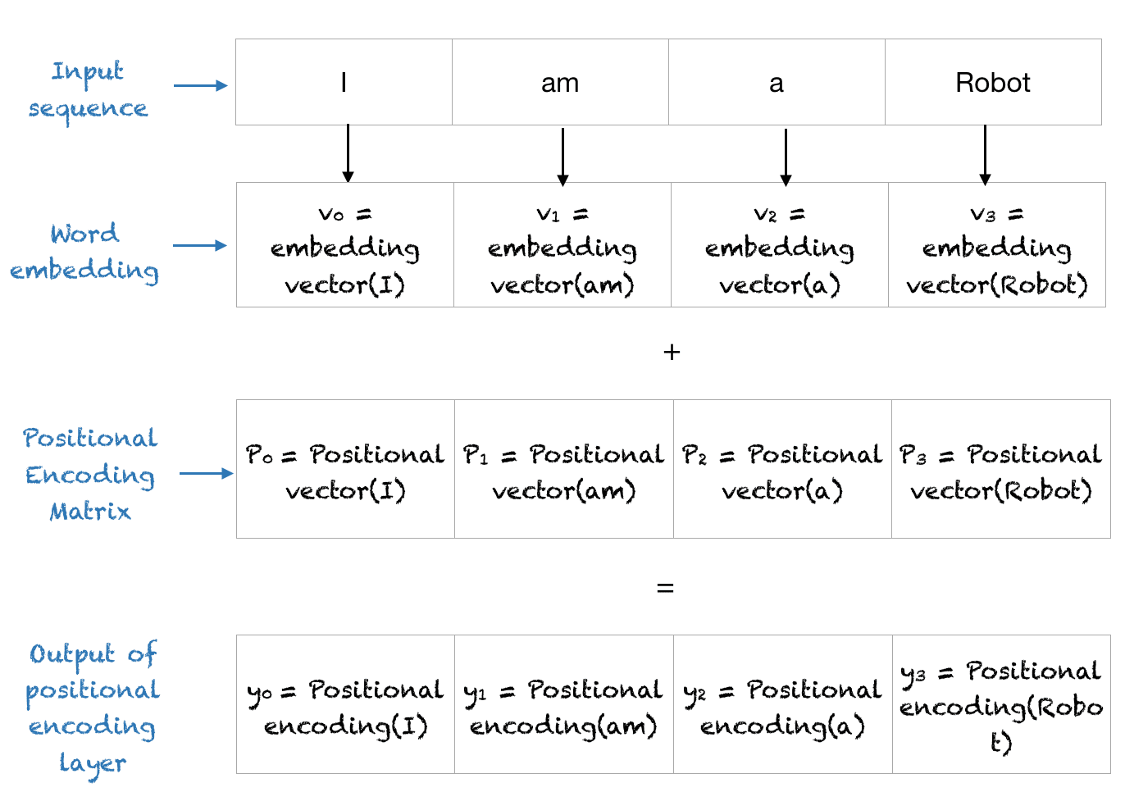
Transforming NLP
Notes:
The other important concept in Transformers is positional encoding:
As Transformers don't have inherent sequential information, positional encoding is employed to inject positional information into the input representations. It enables the model to understand the order of words within a sentence. For example”
I ate an apple while coding an Apple computer
Without positional encoding, with self-attention the model wouldn’t recognise that the first and second apple references are completely different. With positional encoding, what happens is the following:
We basically add to the normal embedding a positional function to distinguish the order of words.

Slide 6
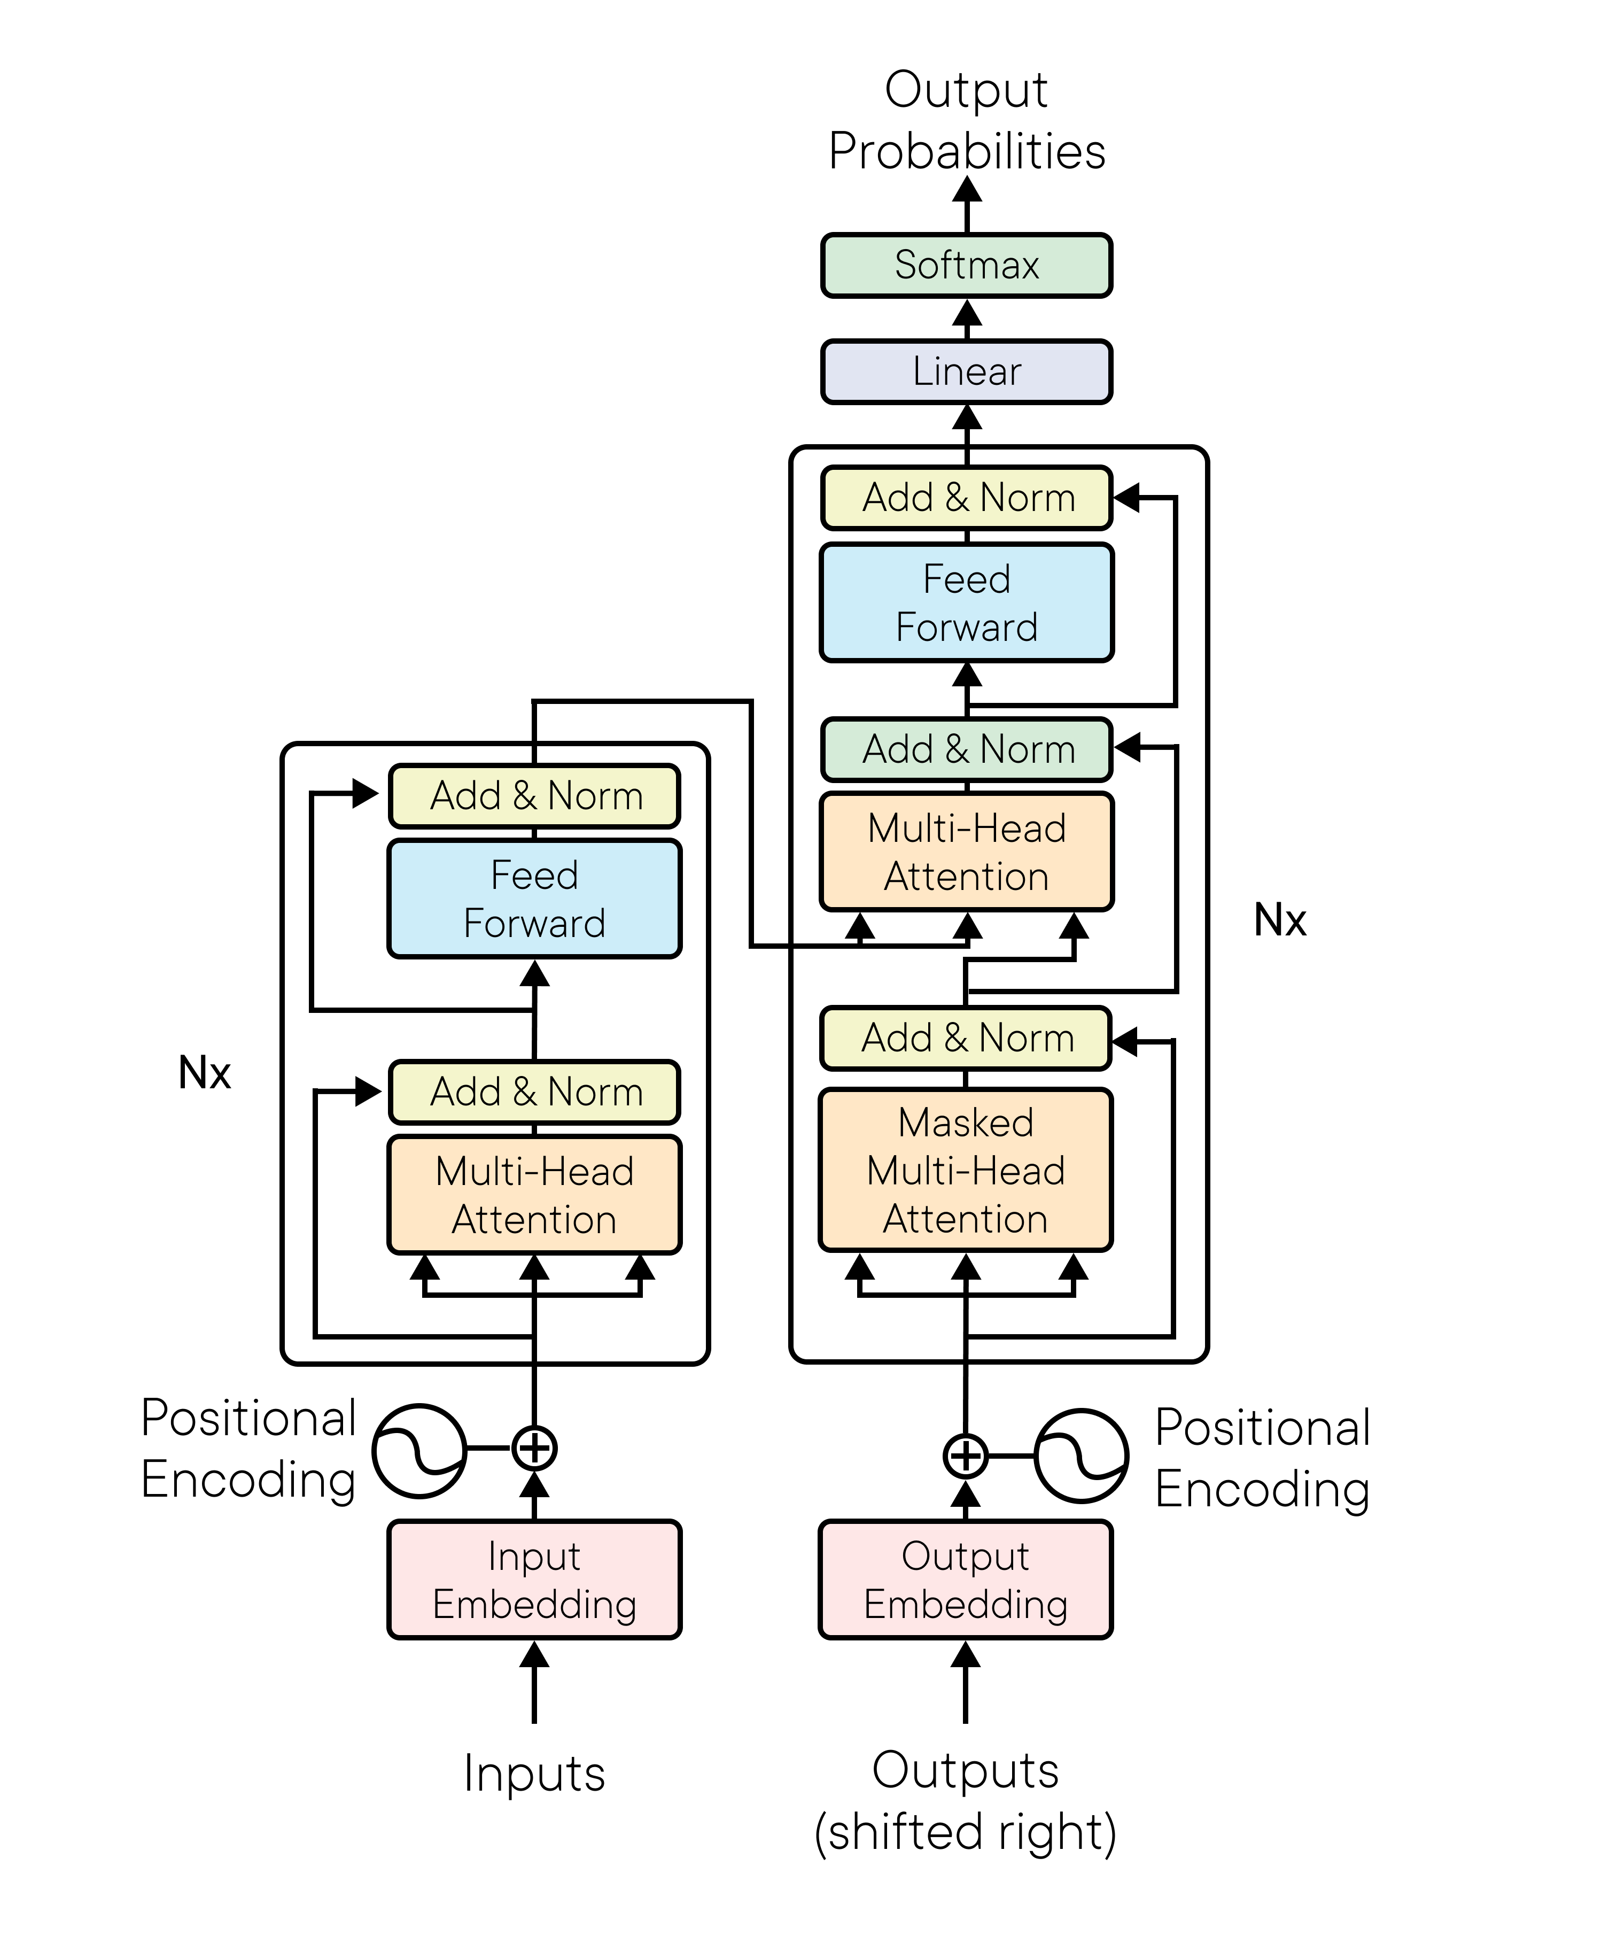
Transforming NLP
Notes:
Now yes, let's get into the Transformer:
I know it sounds daunting, but believe me, we will unravel it piece by piece, and later you will implement it in pure Keras as if you wrote the paper!~

Slide 7
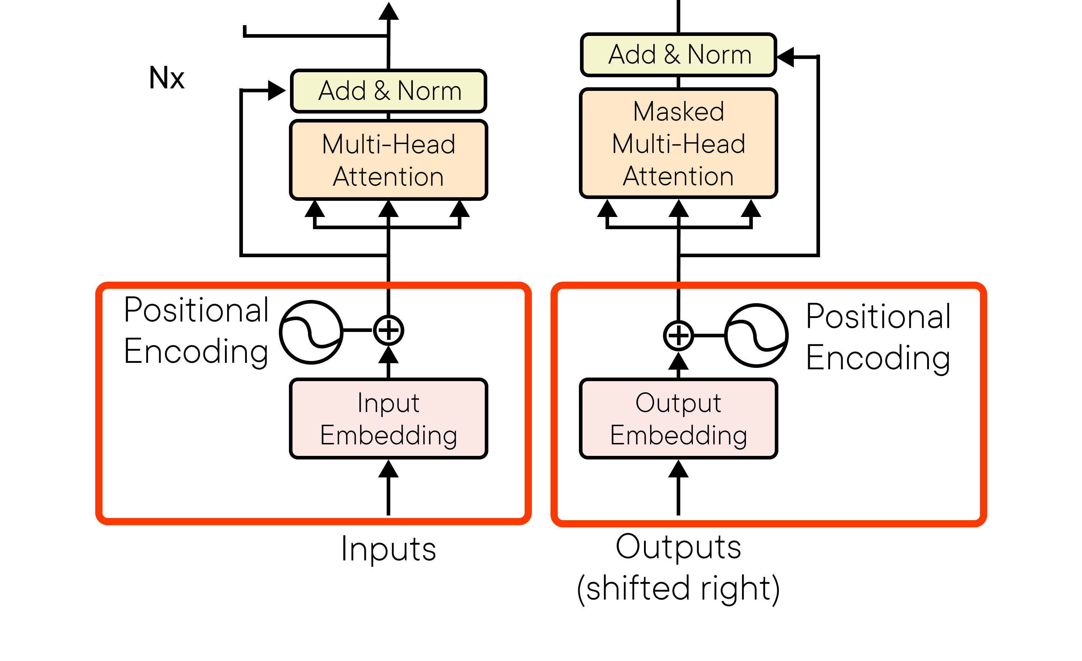
Transforming NLP
Notes:
So first let’s look at the inputs and outputs:
The first part is actually transforming those tensors of Ids into embedded tensors with the meaning of the order; this means that we apply the positional encoding to both input and output. Notice the embedding between input and output may differ, since for example, the language may differ!

Slide 8
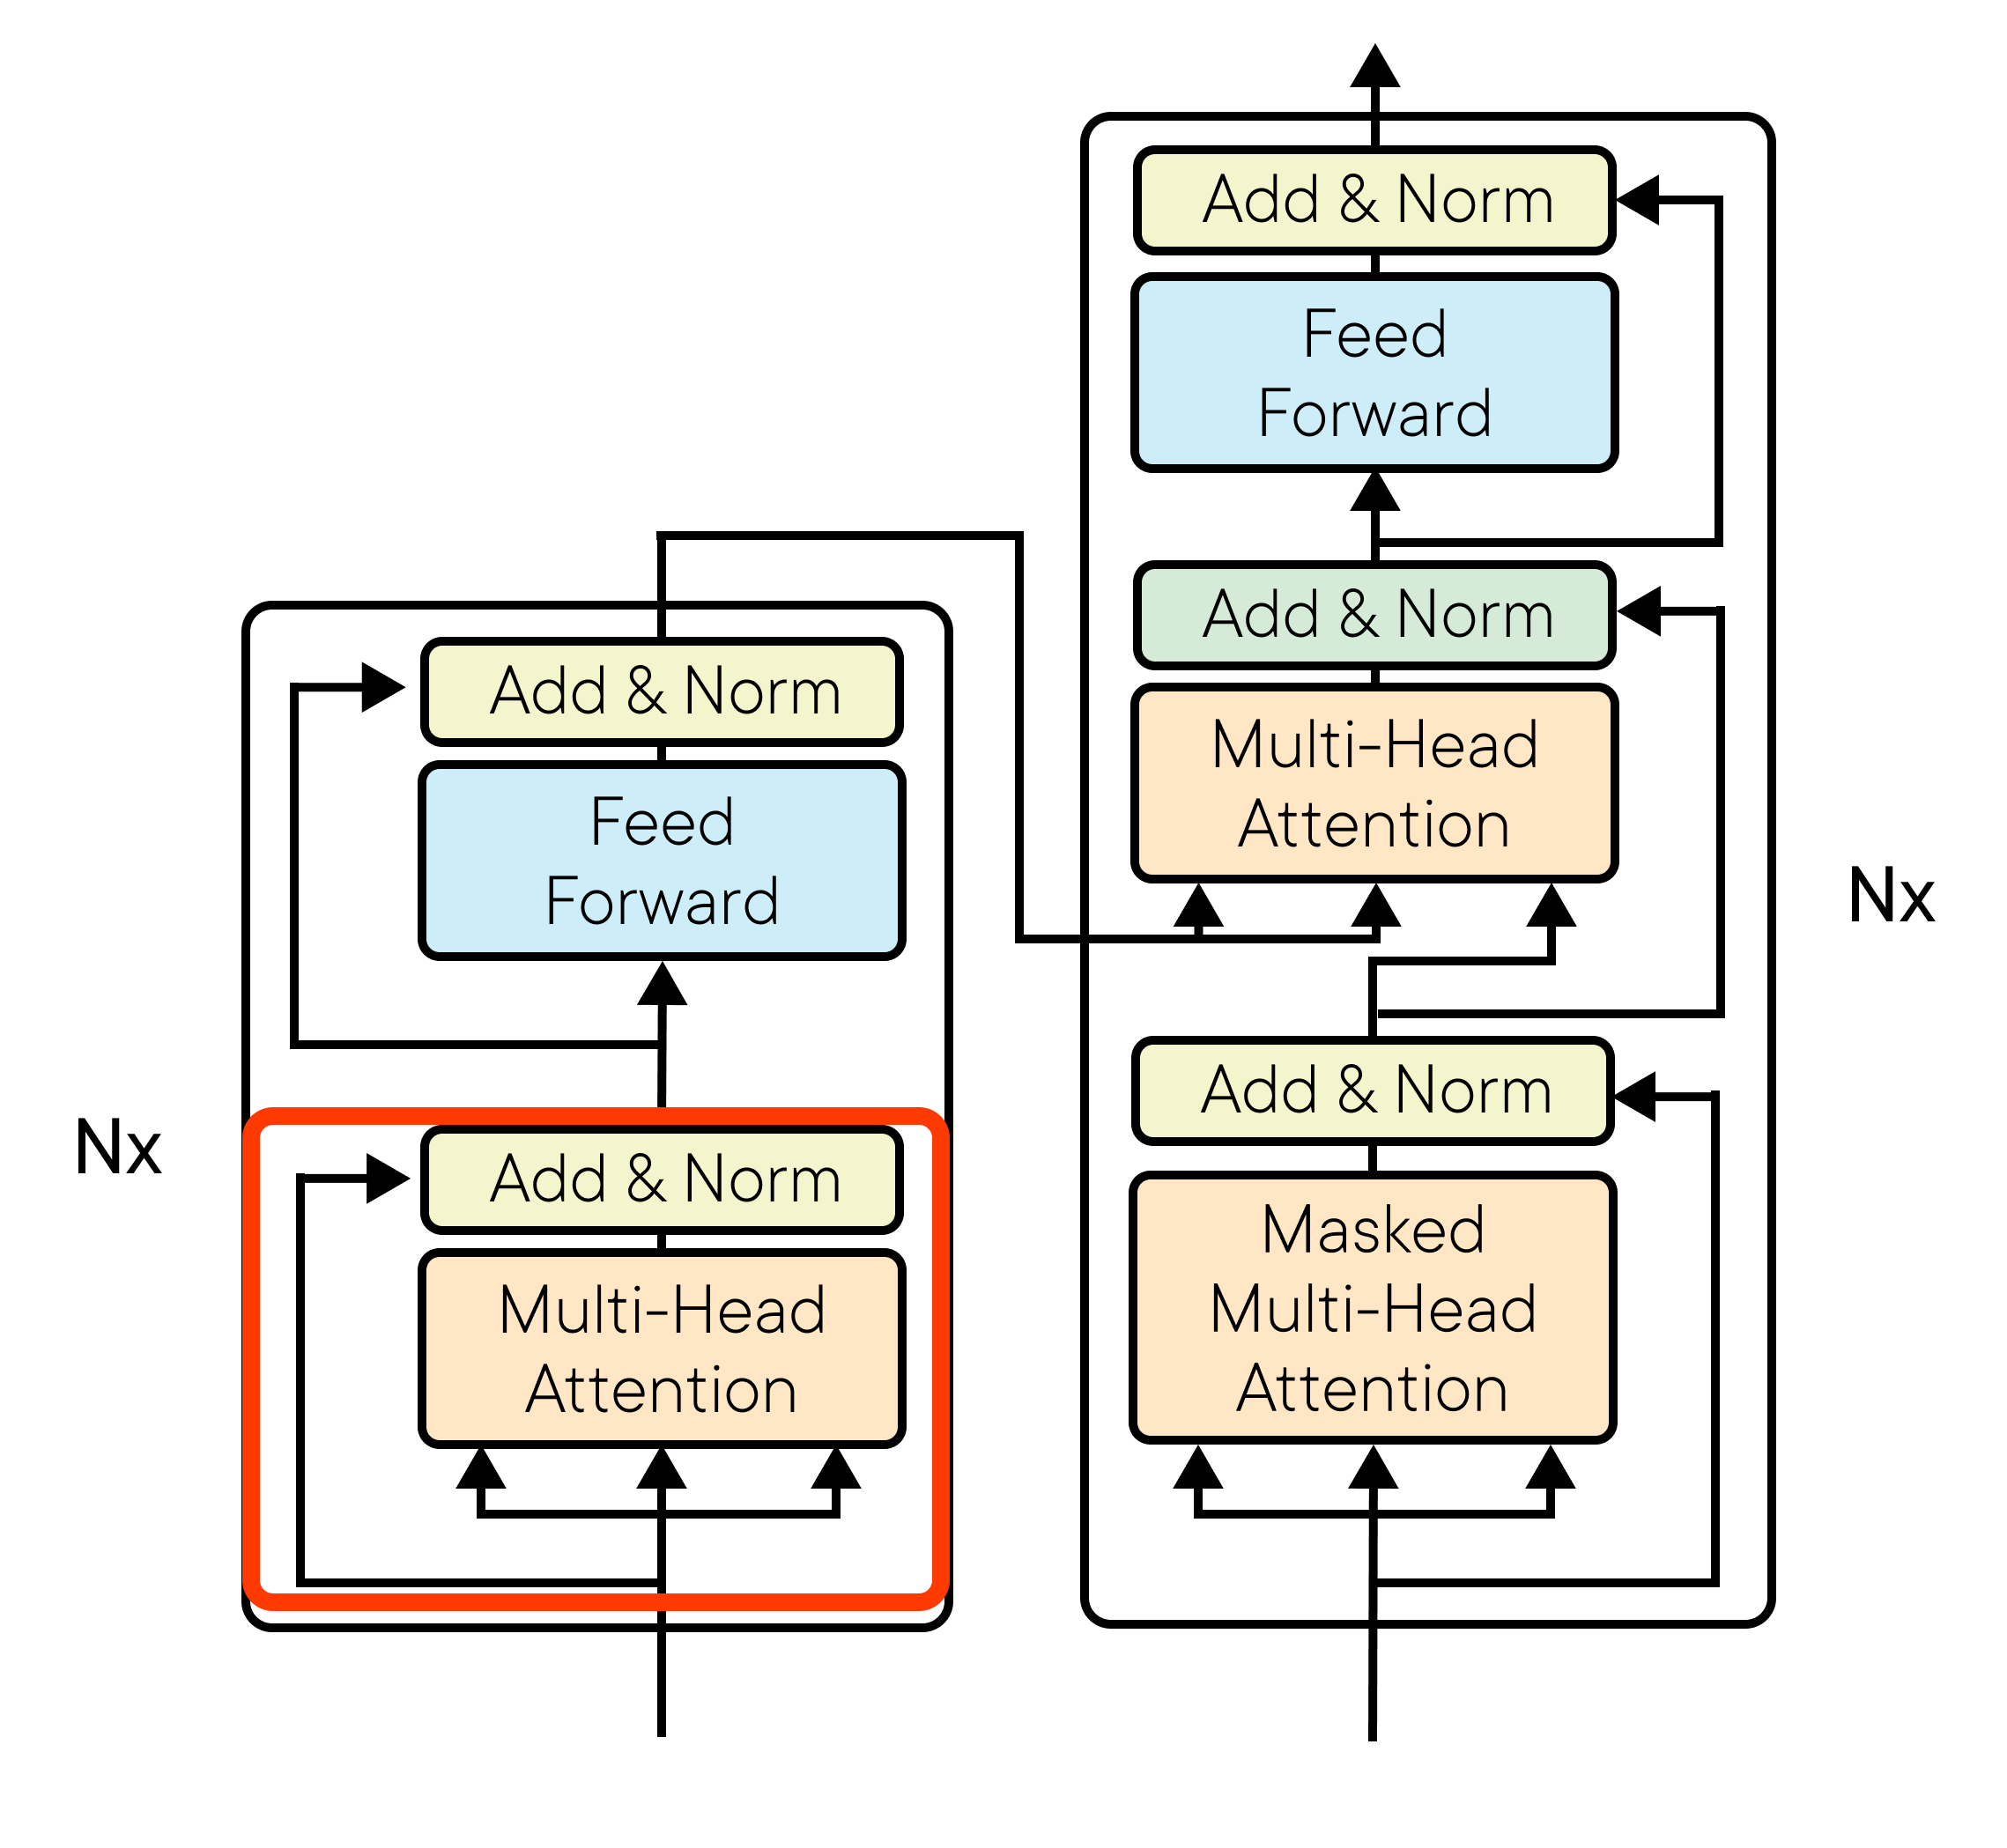
Transforming NLP
Notes:
After that, we enter into the encoder:
First, we run multi-headed attention, where the number of heads is a hyperparameter, and then we add the input of that layer with the output, having a residual connection. We normalise after that to speed up training. This adding and normalise will be very repetitive across the whole architecture, because it works to remember stuff about the past!

Slide 9
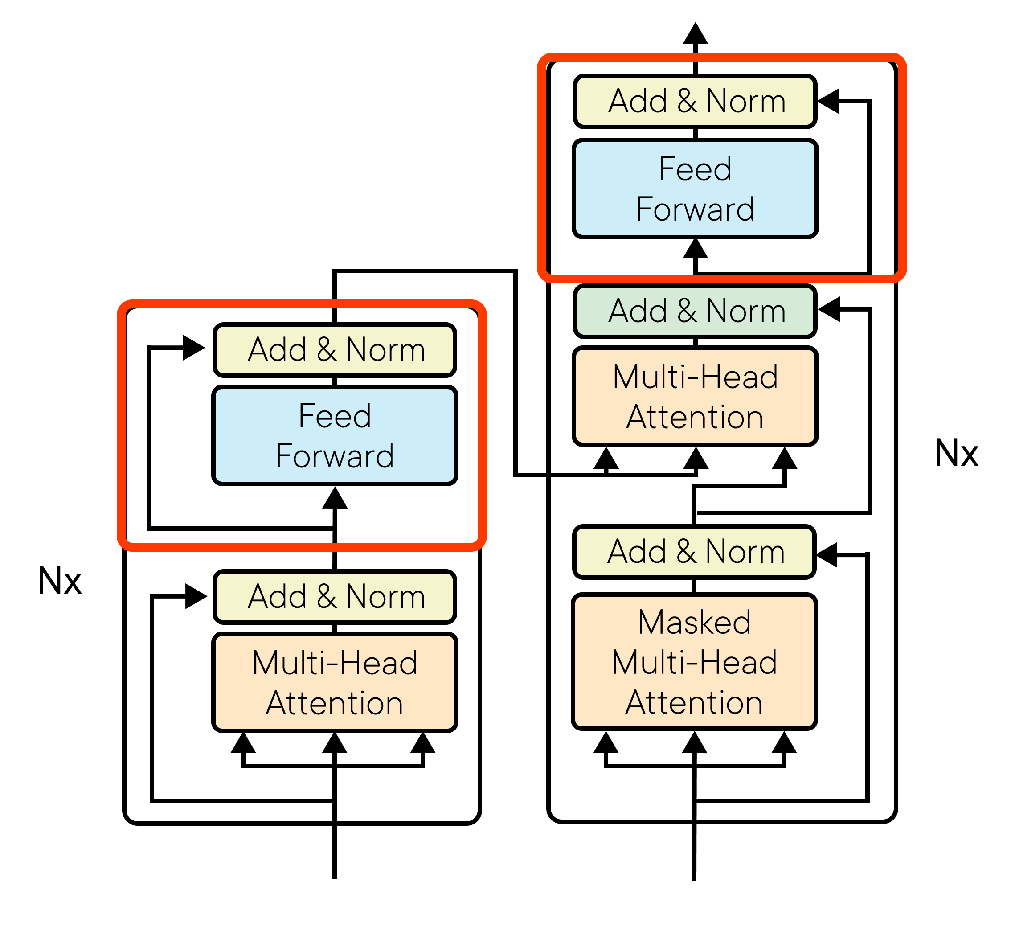
Transforming NLP
Notes:
Later, we have
The feed-forward, which is a normal dense layer, and then again residual connection and normalise! That is our encoder. This encoder can be repeated any number of times, what is important is that the output of the last encoder will be input to each decoder, remember that.

Slide 10
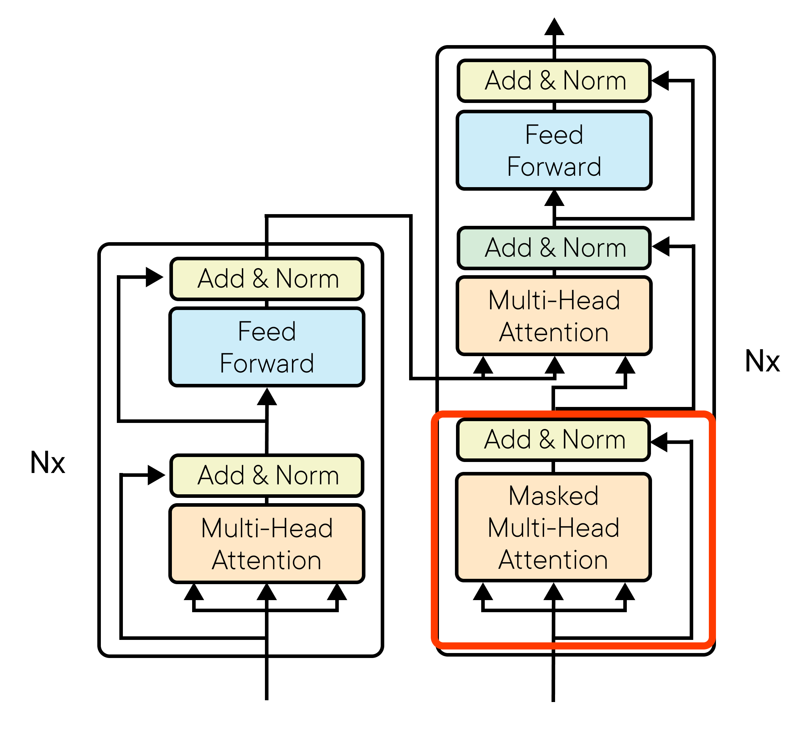
Transforming NLP
Notes:
And since we have started talking about the decoder, why not enter there:
Here we have a multi headed attention as before, but each scaled dot product attention will be masked to avoid looking into the future, that is why it says it has a mask, to avoid looking into a token after yours. That's it, this is the equivalent of that unidirectionality we had in the decoder RNN.

Slide 11
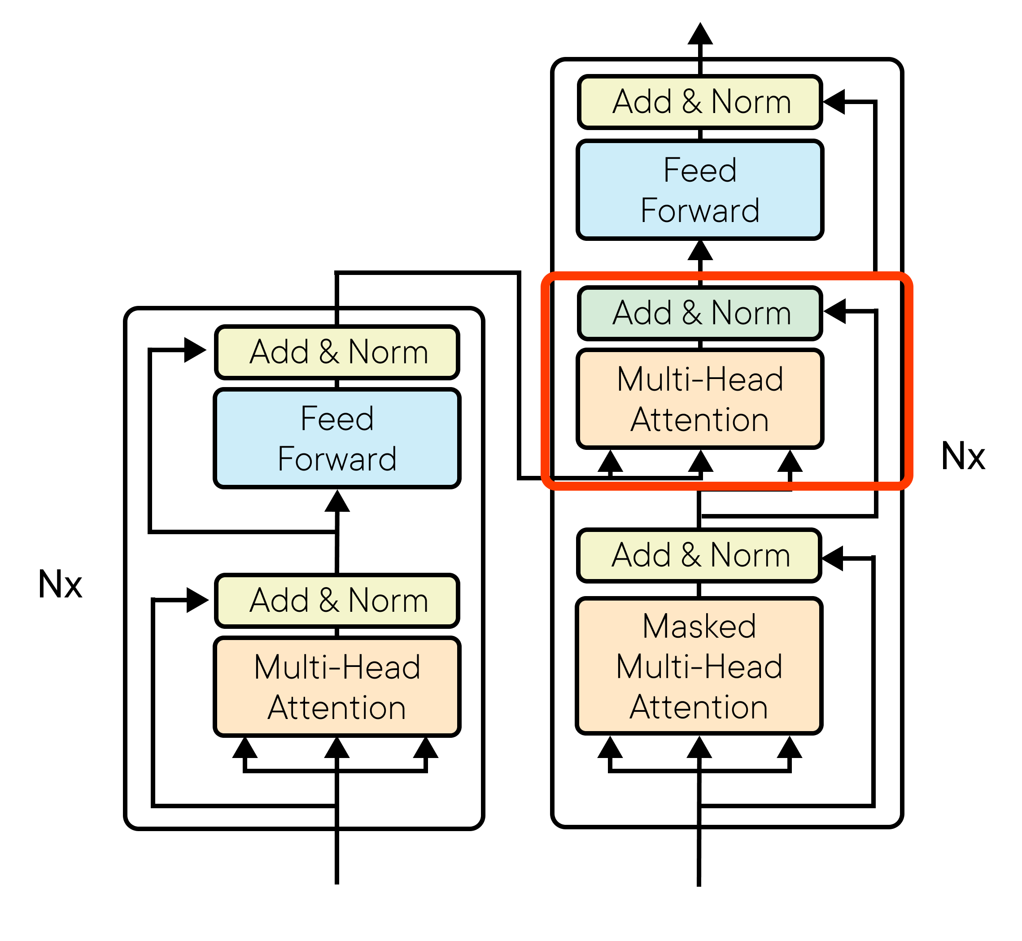
Transforming NLP
Notes:
And finally we have
The normally called cross attention which is a normal multi-headed attention BUT the output of the last encoder will act as key and value here, therefore making the connection between encoder and decoder. And, of course, the add and normalise as before with the residual connection.

Slide 12
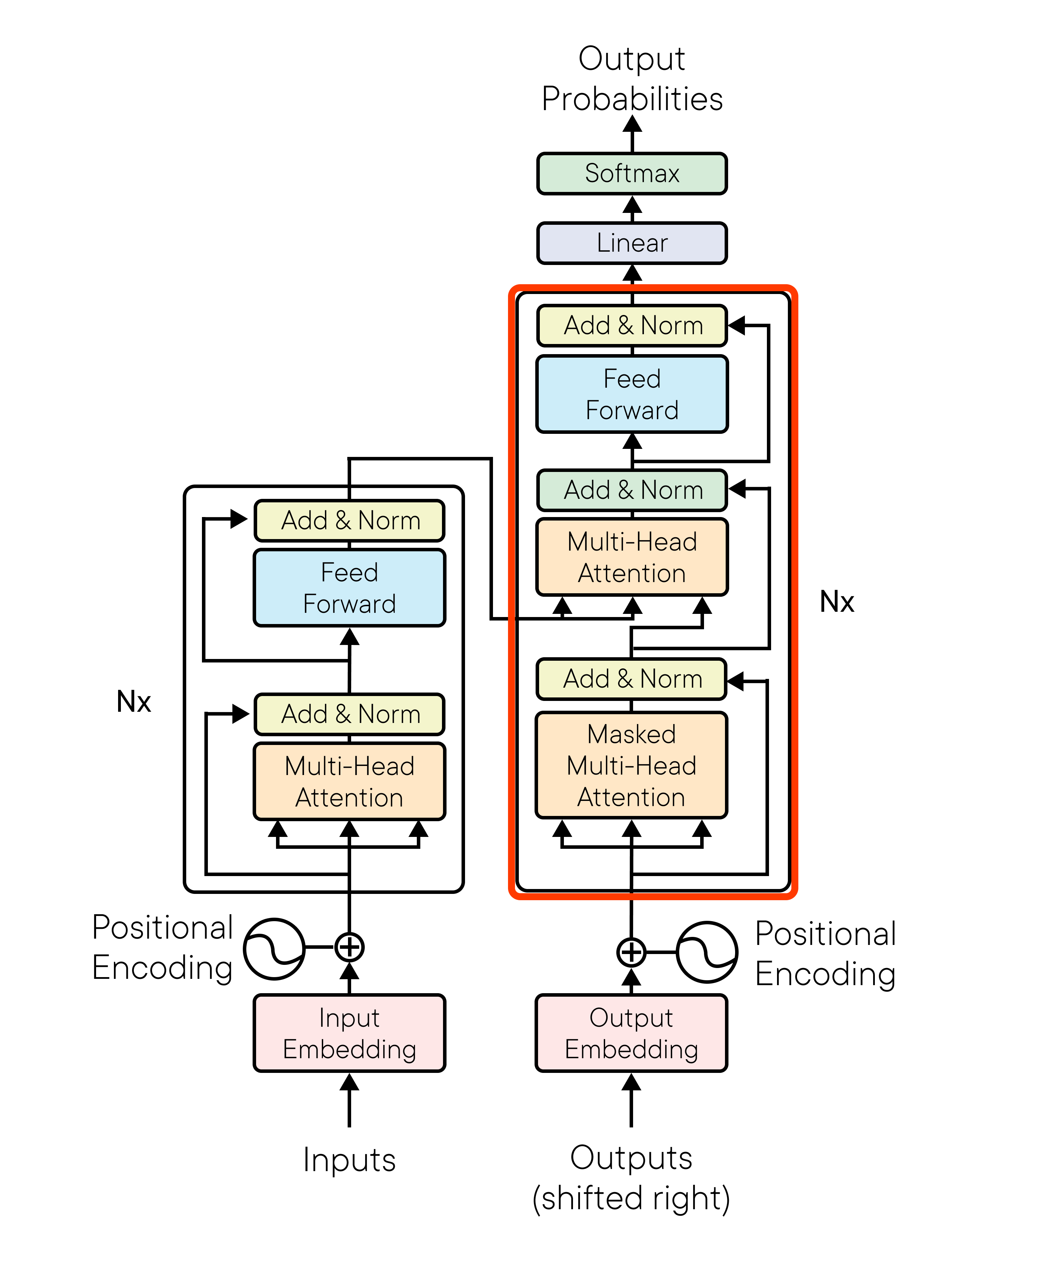
Transforming NLP
Notes:
This decoder
Can be repeated N number of times, and, in the end, we have to do a softmax to output some probabilities over what we try to do, but this is the Transformer!

Slide 13
Why do we need it?
Transforming NLP
Transformers can parallelise computations across a GPU, which RNNs cannot
Transformers do not have the informational bottleneck
And Transformers have much fewer parameters for the same size of architecture than an RNN
Notes:
You may ask, why this? Why do we need it? Well to give a short list:
Transformers can parallelize computations across a GPU, which RNNs cannot
Transformers do not have the informational bottleneck
And transformers have much fewer parameters for the same size of architecture than an RNN
In summary, they are shorter, faster, and better. Makes more sense now to have them, right? Let’s go and implement it!

Slide 14

Lab
Transforming NLP
Our first transformer
Notes:
In this first demo of the module we will implement the Transformer, exactly as in the paper: Attention is all you need. Awesome, right? It’s going to be a tough ride!

Slide 15
Introducing Hugging Face
Transforming NLP
Notes:
Introducing Hugging Face
Now that you have seen the full transformer and the world is in your hands, we will make it easier. We're diving into the world of Hugging Face, a platform that has become a game-changer in Natural Language Processing. So, grab your notebooks and get ready to explore the power of Hugging Face!

Slide 16

Hugging Face
Transforming NLP
Hugging Face is an open-source library and plataforma that provides a wide range of tolos and models for NLP tasks.
Notes:
Hugging Face is an open-source library and platform that provides a wide range of tools and models for NLP tasks. It's been embraced by researchers, developers, and enthusiasts alike, revolutionising the way we work with language data.

Slide 17
Features
Transforming NLP
Pretrained Models: Hugging Face provides a vast collection of pretrained models, including popular architectures like BERT, GPT and many more.
Transformers Library: The Transformers Library, developed by Hugging Face, is a go-to resource for NLP practitioners.
Datasets library: At your disposal, you have the datasets library to download tons of famous datasets along with their metrics to compare your models with the current state of the art.
Notes:
Among its features we have
Pretrained Models: Hugging Face provides a vast collection of pretrained models, including popular architectures like BERT, GPT, and many more. These models have been trained on massive amounts of data, enabling you to leverage their power for various NLP tasks without starting from scratch.
Transformers Library The Transformers library, developed by Hugging Face, is a go-to resource for NLP practitioners. It allows you to easily access, download, and fine-tune pretrained models for your specific tasks. With just a few lines of code, you can implement complex NLP models efficiently.
Datasets library: At your disposal, you have the datasets library to download tons of famous datasets along with their metrics to compare your models with the current state of the art.

Slide 18
In code
index.py
Transforming NLP
import tensorflow as tf from transformers import AutoTokenizer, TFAutoModelForSequenceClassification from datasets import load_dataset from sklearn.model_selection import train_test_split # Download and load the tokenizer and model model_name = "distilbert-base-uncased" tokenizer = AutoTokenizer.from_pretrained(model_name) model = TFAutoModelForSequenceClassification.from_pretrained(model_name, num_labels=2) # Load the IMDb dataset from Hugging Face datasets library dataset = load_dataset("imdb") # Split the dataset into training and testing sets train_dataset, test_dataset = train_test_split(dataset['train'], test_size=0.2, random_state=42) # Tokenize the training dataset train_encodings = tokenizer(train_dataset['text'], truncation=True, padding=True) train_labels = train_dataset['label'] # Tokenize the testing dataset test_encodings = tokenizer(test_dataset['text'], truncation=True, padding=True) test_labels = test_dataset['label']
1. Download and load the tokenizer and model

Slide 19
In code
index.py
Transforming NLP
import tensorflow as tf from transformers import AutoTokenizer, TFAutoModelForSequenceClassification from datasets import load_dataset from sklearn.model_selection import train_test_split # Download and load the tokenizer and model model_name = "distilbert-base-uncased" tokenizer = AutoTokenizer.from_pretrained(model_name) model = TFAutoModelForSequenceClassification.from_pretrained(model_name, num_labels=2) # Load the IMDb dataset from Hugging Face datasets library dataset = load_dataset("imdb") # Split the dataset into training and testing sets train_dataset, test_dataset = train_test_split(dataset['train'], test_size=0.2, random_state=42) # Tokenize the training dataset train_encodings = tokenizer(train_dataset['text'], truncation=True, padding=True) train_labels = train_dataset['label'] # Tokenize the testing dataset test_encodings = tokenizer(test_dataset['text'], truncation=True, padding=True) test_labels = test_dataset['label']
2. Load the IMDB dataset from Hugging Face datasets library

Slide 20
In code
index.py
Transforming NLP
import tensorflow as tf from transformers import AutoTokenizer, TFAutoModelForSequenceClassification from datasets import load_dataset from sklearn.model_selection import train_test_split # Download and load the tokenizer and model model_name = "distilbert-base-uncased" tokenizer = AutoTokenizer.from_pretrained(model_name) model = TFAutoModelForSequenceClassification.from_pretrained(model_name, num_labels=2) # Load the IMDb dataset from Hugging Face datasets library dataset = load_dataset("imdb") # Split the dataset into training and testing sets train_dataset, test_dataset = train_test_split(dataset['train'], test_size=0.2, random_state=42) # Tokenize the training dataset train_encodings = tokenizer(train_dataset['text'], truncation=True, padding=True) train_labels = train_dataset['label'] # Tokenize the testing dataset test_encodings = tokenizer(test_dataset['text'], truncation=True, padding=True) test_labels = test_dataset['label']
2. Split the dataset into training and testing sets

Slide 21
In code
index.py
Transforming NLP
import tensorflow as tf from transformers import AutoTokenizer, TFAutoModelForSequenceClassification from datasets import load_dataset from sklearn.model_selection import train_test_split # Download and load the tokenizer and model model_name = "distilbert-base-uncased" tokenizer = AutoTokenizer.from_pretrained(model_name) model = TFAutoModelForSequenceClassification.from_pretrained(model_name, num_labels=2) # Load the IMDb dataset from Hugging Face datasets library dataset = load_dataset("imdb") # Split the dataset into training and testing sets train_dataset, test_dataset = train_test_split(dataset['train'], test_size=0.2, random_state=42) # Tokenize the training dataset train_encodings = tokenizer(train_dataset['text'], truncation=True, padding=True) train_labels = train_dataset['label'] # Tokenize the testing dataset test_encodings = tokenizer(test_dataset['text'], truncation=True, padding=True) test_labels = test_dataset['label']
4. Tokenize the datasets

Slide 22
In code
index.py
Transforming NLP
# Create TensorFlow datasets train_dataset = tf.data.Dataset.from_tensor_slices((dict(train_encodings), train_labels)).batch(16) test_dataset = tf.data.Dataset.from_tensor_slices((dict(test_encodings), test_labels)).batch(16)
# Configure training parameters optimizer = tf.keras.optimizers.Adam(learning_rate=1e-5) loss = tf.keras.losses.SparseCategoricalCrossentropy(from_logits=True) model.compile(optimizer=optimizer, loss=loss, metrics=["accuracy"])
# Train the model model.fit(train_dataset, epochs=3)
# Evaluate the model results = model.evaluate(test_dataset) print("Test Loss:", results[0]) print("Test Accuracy:", results[1])
Create TensorFlow datasets

Slide 23
In code
index.py
Transforming NLP
# Create TensorFlow datasets train_dataset = tf.data.Dataset.from_tensor_slices((dict(train_encodings), train_labels)).batch(16) test_dataset = tf.data.Dataset.from_tensor_slices((dict(test_encodings), test_labels)).batch(16)
# Configure training parameters optimizer = tf.keras.optimizers.Adam(learning_rate=1e-5) loss = tf.keras.losses.SparseCategoricalCrossentropy(from_logits=True) model.compile(optimizer=optimizer, loss=loss, metrics=["accuracy"])
# Train the model model.fit(train_dataset, epochs=3)
# Evaluate the model results = model.evaluate(test_dataset) print("Test Loss:", results[0]) print("Test Accuracy:", results[1])
Configure training parameters

Slide 24
In code
index.py
Transforming NLP
# Create TensorFlow datasets train_dataset = tf.data.Dataset.from_tensor_slices((dict(train_encodings), train_labels)).batch(16) test_dataset = tf.data.Dataset.from_tensor_slices((dict(test_encodings), test_labels)).batch(16)
# Configure training parameters optimizer = tf.keras.optimizers.Adam(learning_rate=1e-5) loss = tf.keras.losses.SparseCategoricalCrossentropy(from_logits=True) model.compile(optimizer=optimizer, loss=loss, metrics=["accuracy"])
# Train the model model.fit(train_dataset, epochs=3)
# Evaluate the model results = model.evaluate(test_dataset) print("Test Loss:", results[0]) print("Test Accuracy:", results[1])
Train the model

Slide 25
In code
index.py
Transforming NLP
# Create TensorFlow datasets train_dataset = tf.data.Dataset.from_tensor_slices((dict(train_encodings), train_labels)).batch(16) test_dataset = tf.data.Dataset.from_tensor_slices((dict(test_encodings), test_labels)).batch(16)
# Configure training parameters optimizer = tf.keras.optimizers.Adam(learning_rate=1e-5) loss = tf.keras.losses.SparseCategoricalCrossentropy(from_logits=True) model.compile(optimizer=optimizer, loss=loss, metrics=["accuracy"])
# Train the model model.fit(train_dataset, epochs=3)
# Evaluate the model results = model.evaluate(test_dataset) print("Test Loss:", results[0]) print("Test Accuracy:", results[1])
Evaluate the model

Slide 26
Demo
Transforming NLP
Prompt Engineering with Flan-t5
Notes:
In this short demo, we will use a version of the distillBERT transformer to perform transfer learning to do sentiment analysis

Slide 27
Demo
Transforming NLP
Transfer learning on Transformers with Hugging Face
Notes:
In this short demo, we will use a version of the distillBERT transformer to perform transfer learning to do sentiment analysis

Slide 28

Summary
Transforming NLP
The Transformer architecture solved all of the significant challenges we had with RNNs for sequence models
With Hugging Face, now it most straightforward tan ever just to graba checkpoint from someone and finetune it to your needs
Some models like T5 can perform on multiple task because that’s how they were trained and we can leverage it
Notes:
This module has been all about transformers. Some takeaways are
The Transformer architecture solved all of the significant challenges we had with RNNs for sequence models
With HuggingFace, now it is most straightforward than ever just to grab a checkpoint from someone and finetune it to your needs
Some models like T5 can perform on multiple tasks because that’s how they were trained and we can leverage it.

